Slide 1



Creating Culture
Billie Sue Smith
Paradigm Shift Leadership
billie@ps.company

Slide 2

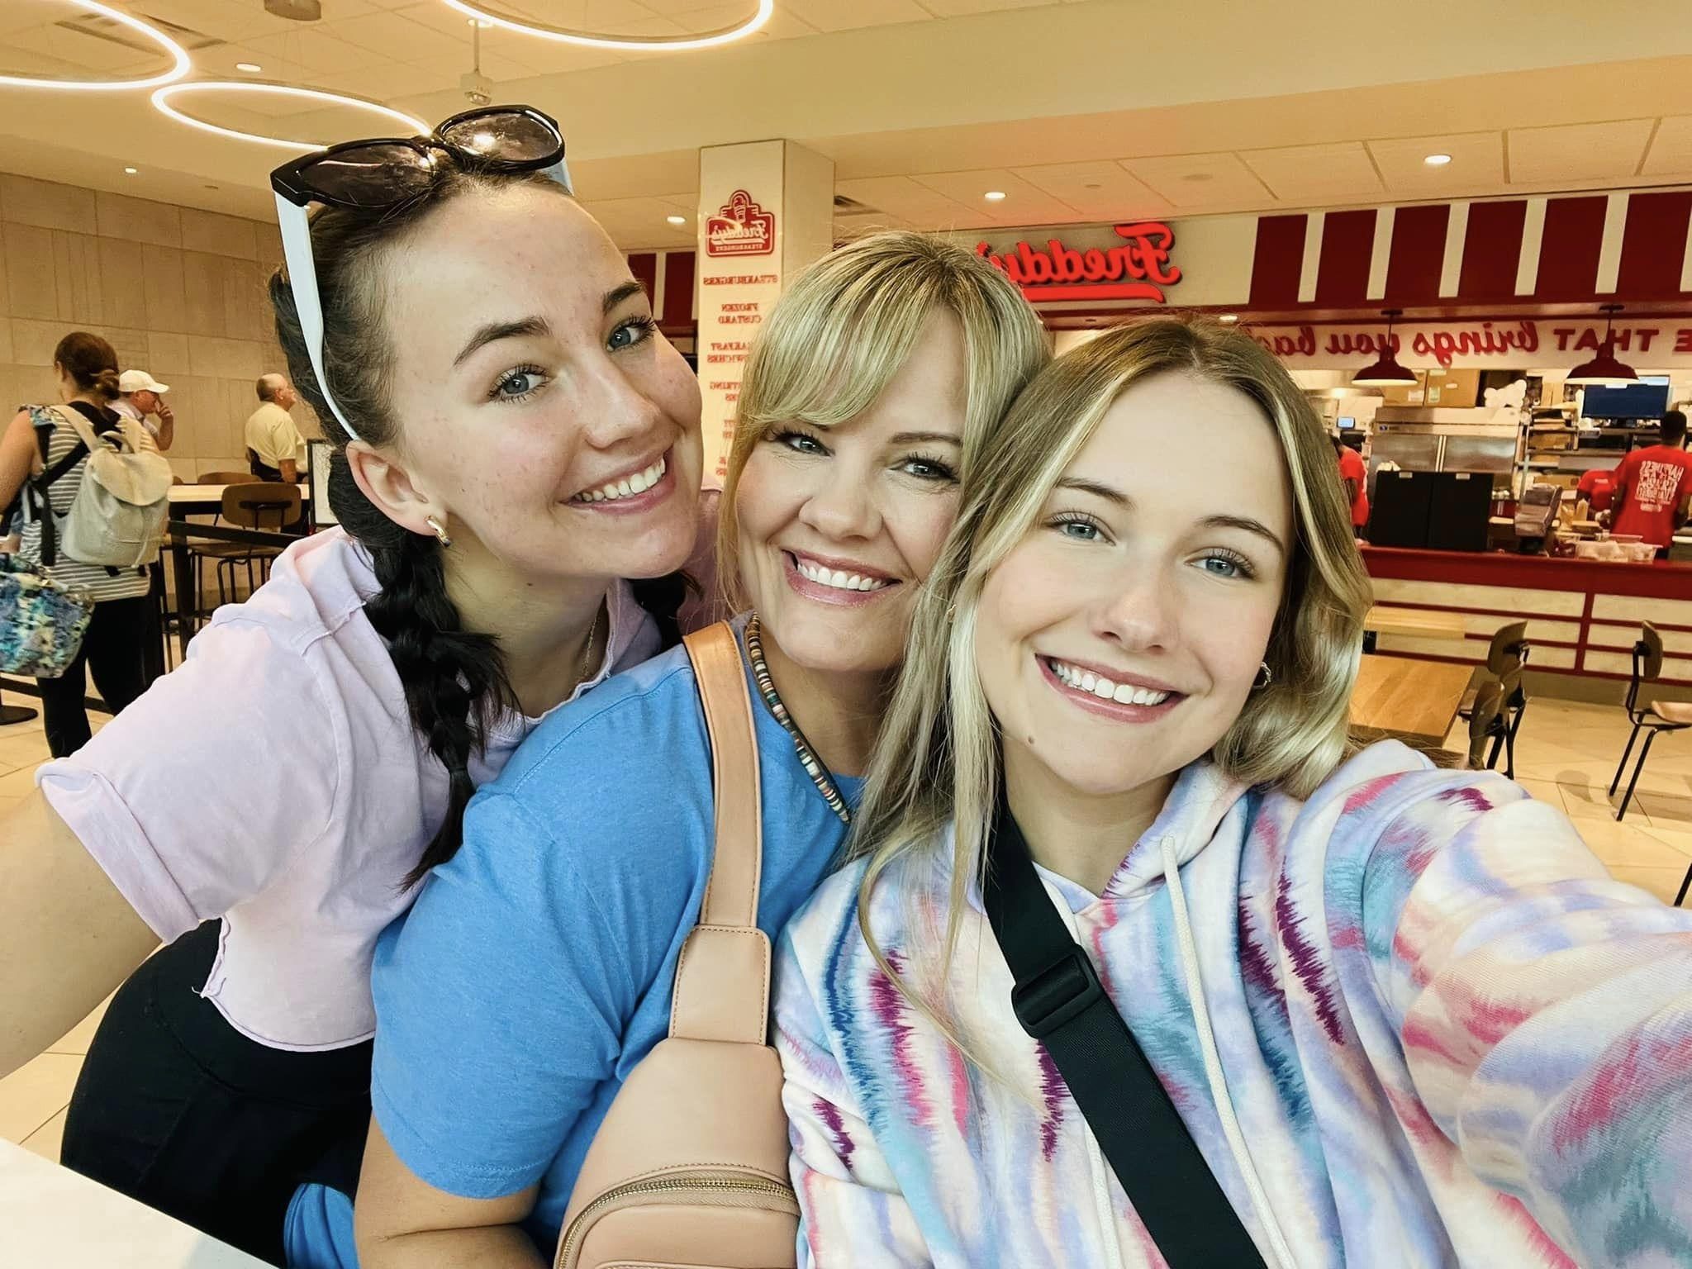


Slide 3
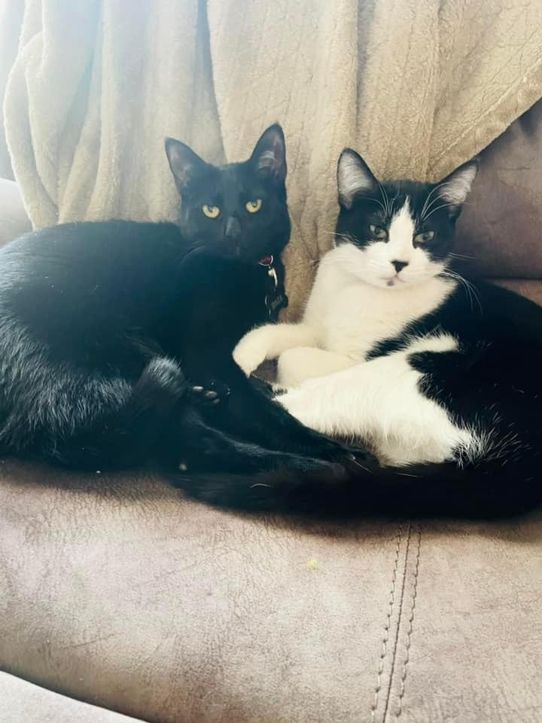

Slide 6
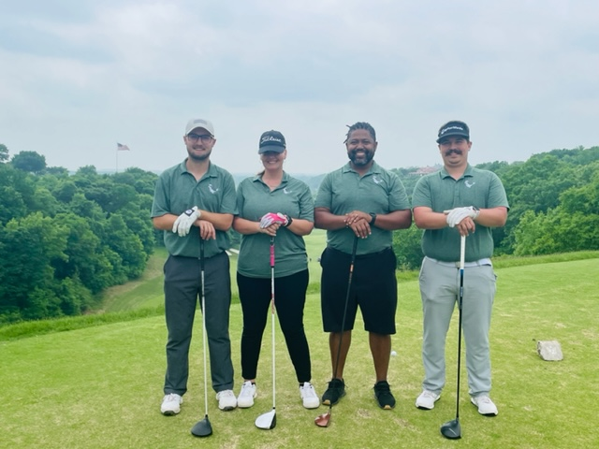

Slide 7

Animal Cards

Slide 8

Culture exists regardless of whether or not we choose to be intentional with it.

Slide 9

“Culture is the customs, arts, social institutions, and achievements of a particular nation, people, or other social group.”

Slide 10

Four Major Culture Identifiers

Slide 11

Language
Food
Arts
Beliefs and values

Slide 12
Snowball
Describe your workplace culture using the four identifiers

Slide 13
Four Common Culture Traps

Slide 14
Cultural Bias
The humor test
The false understanding assumption
Misplaced priorities

Slide 15
Three Systems of Culture

Slide 16
Culture makers
Culture keepers
Culture breakers

Slide 17
“Culture is knowing who we want to be and creating systems that reinforce that.”

Slide 18
How does a fun culture benefit your workplace?

Slide 19
Engaged employees are more productive and connected
Attracts new talent
Increases revenue

Slide 20
Generations

Slide 21
Boomers 1946-1964
Millennials 1981-1996
Gen Z 1997-2012
Gen X 1965-1980
Alpha 2013-2025

Slide 22
Do you prefer remote work or in office?
Unlimited PTO or higher pay?
What types of bonding activities do you enjoy at work?

Slide 23


Slide 24
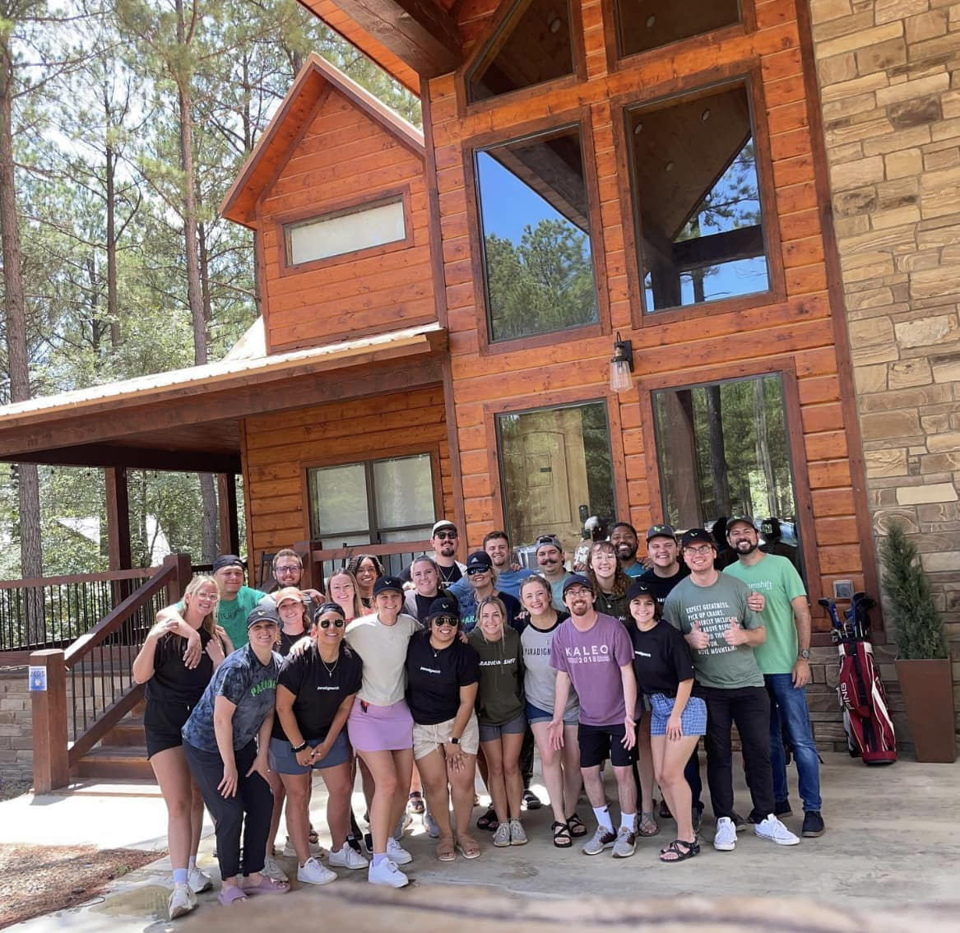

Slide 25
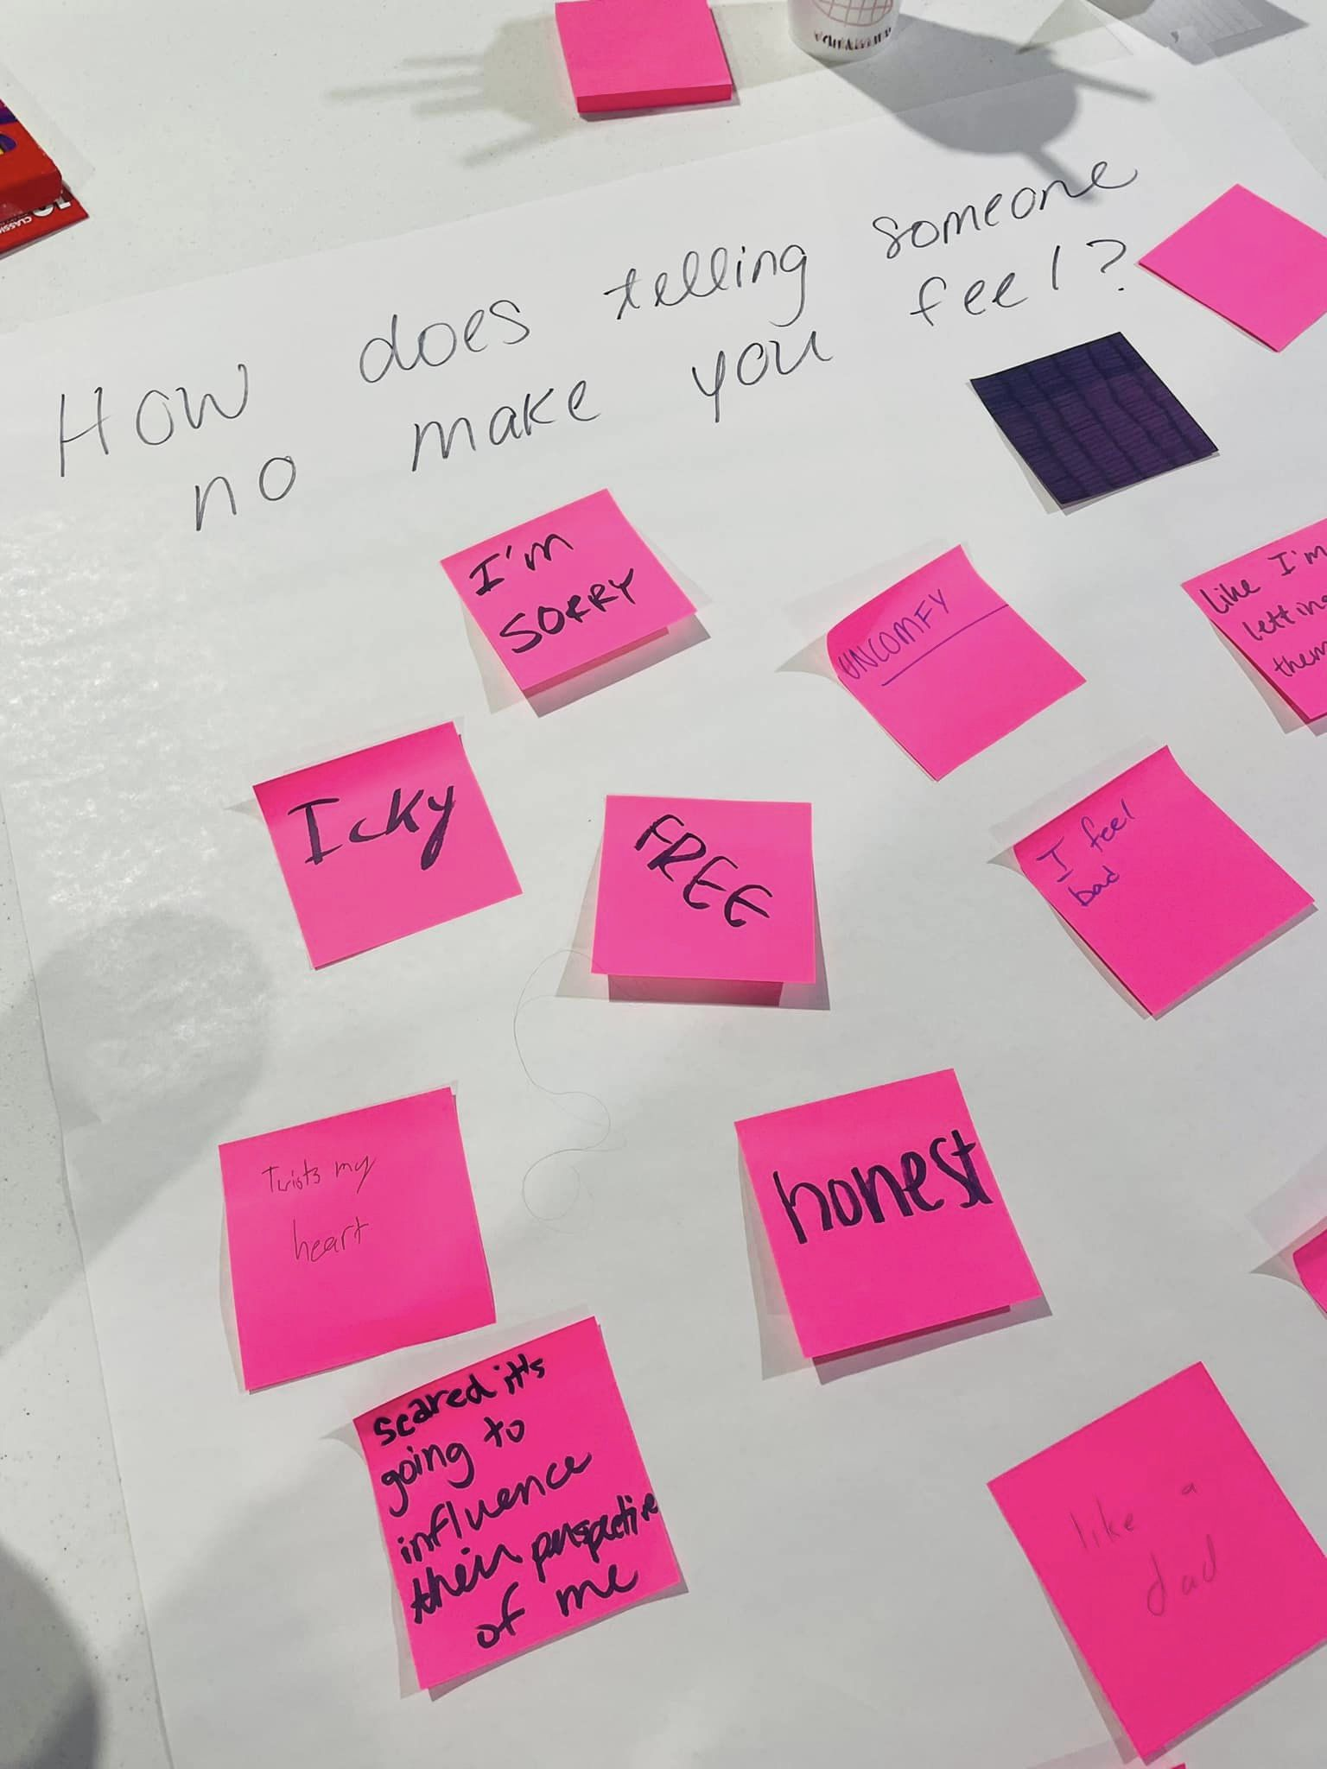

Slide 26

Creating Culture is Like Baking a Cake

Slide 27
Have the right ingredients
Mix it up
Bake the cake…then ask how it tastes!

Slide 28
Accountability Without Accusation

Slide 29
“Accountability is paramount for values-based leadership. We must accept accountability for our actions and hold others accountable to maintain integrity, compassion, respect and excellence.”

Slide 30
Values
Write down three values in your workplace and trade three times

Slide 31
Five W’s of Accountability

Slide 32
Who made the mistake?
What caused them to make the mistake?
When did the mistake occur?
Where did it occur?
Why did it happen?

Slide 33
“The “Why” is absolutely critical to implementing a culture of accountability without accusation.”

Slide 34
Three Ways to Achieve Accountability

Slide 35
Fear short-term gain only
Oversight micro managing v expectations
Trust long term and upheld at every level

Slide 36
How can you create accountability without accusation?

Slide 37
Build trust
Ask versus accusing
Determine intent
Define expectations

Slide 38
Give responsibility and authority
Care about the person, not just the task
Praise for the common good

Slide 39
